Slide 1
Database Principles

Slide 2
Basics
A database is a collection of data, along with the relationships between the data, organized for efficient retrieval
The data has to be entered into a structure, maintained and kept up to date, and accessed (via reports or online queries)
This is database management
The programs which help you do this are called database management systems DBMS

Slide 3
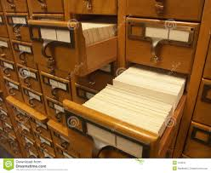
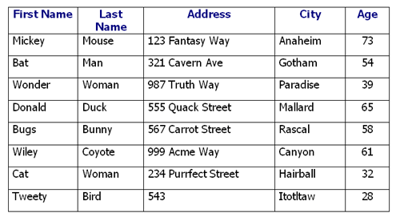
Old database vs. New database

Slide 4
Uses for a database
Every company needs one! Businesses have lots of data to manage, from inventory and suppliers to employees and salary!
Databases produce useful reports, shipping labels, answers to questions about the data contained in the database
You may or may not actually use MS Access at your job, but you DO use a DBMS very often. Many have specialized, customized interfaces that you might not recognize as a DBMS.

Slide 5
Data Mining
Hot topic these days with “Big Data”
The process of extracting hidden patterns from data (Wikipedia)
Businesses and governments do it all the time (finding prospects, detecting terrorism)
Analyze large amounts of data for previously unknown and useful information, using AI programs that can find interesting relationships and patterns
Can also invade privacy if not use carefully
Patterns used to make predictions

Slide 6
Well known DBMS’s
MS Access – only good for medium amounts of data
Oracle – for huge amounts of data, used by large companies
mySQL – ecommerce, shopping baskets, catalogs, runs on Linux, free, open-source
SAP – enterprise, integrated system for managing a business and its data
IBM DB2 – older, still well respected for businesses

Slide 7
Basic Terms
The simplest unit in a database is a field.
It is the smallest meaningful unit.
It can be any size from 1 character to hundreds of characters
It has a name, like “First Name” or “State”
It has a type, like “Text” – more on this later!
It has properties, like being a primary key or having a default value

Slide 8
Then comes a record
Put some fields together because they are logically related and you call it a record
A record is all the information you have in a database about one “object” – “object” is a loose term, a person, a date, a transation, all are objects
A record could have 1 field (unusual) or many fields, of any types as needed
A collection of fields about a student in a university database would be the student’s record

Slide 9
Then comes a table
Put some records together because they are logically associated (they are all students or they are all inventory items) and you have a table.
A table could have 1 record (unusual) or millions (can be slow to access or sort!)
Tables have names like “Employees” or “Departments” or “Products made” or “Sales”

Slide 10
And lastly comes a database
Put together some tables because they are all logically related and you have a database.
Note that is a database, NOT a DBMS. The DBMS is the software that manipulates the data in the database
A database may have one table or many, depending on the complexity of the data and the size of the entity (company or person) that the data represents

